Slide 1
Batik

Slide 2
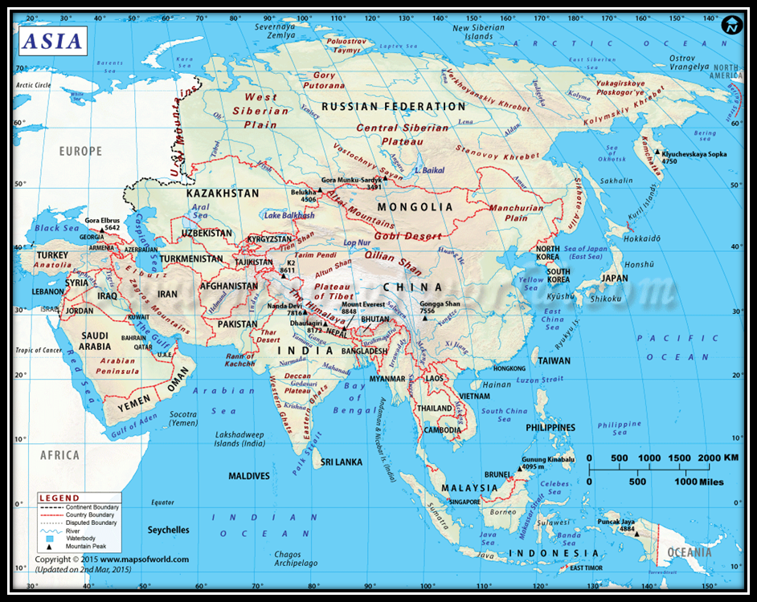
Samples of dye resistance patterns on cloth can be traced back 1,500 years ago to Egypt and the Middle East. Samples have also been found in Turkey, India, China, Japan and West Africa from past centuries.

Slide 3
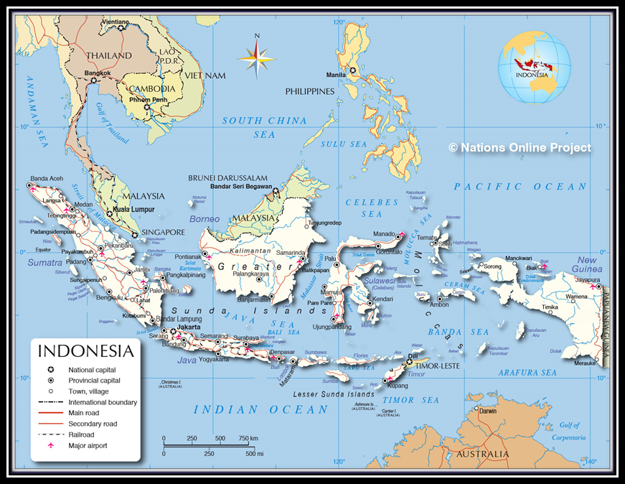

Slide 4
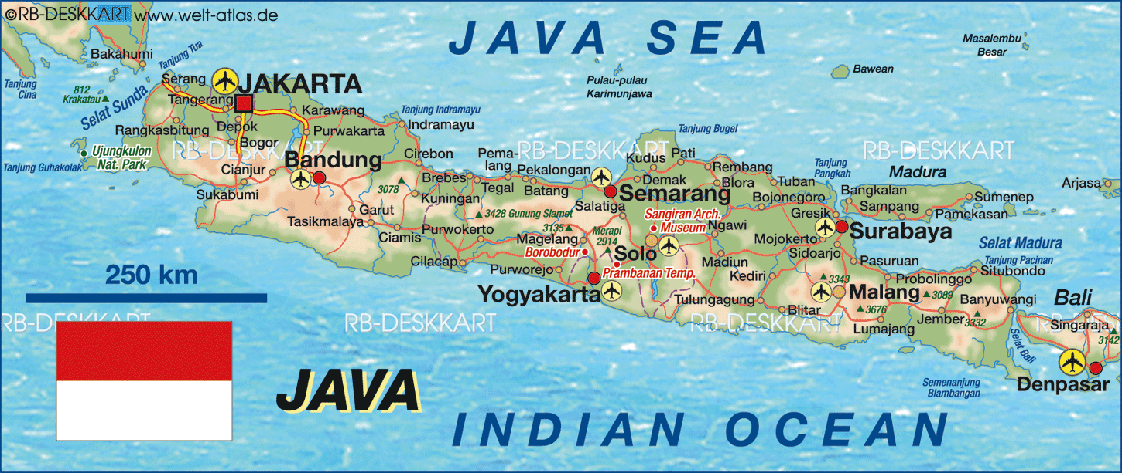
The island of Java in Indonesia is known to have developed batik to its present day art form.

Slide 5
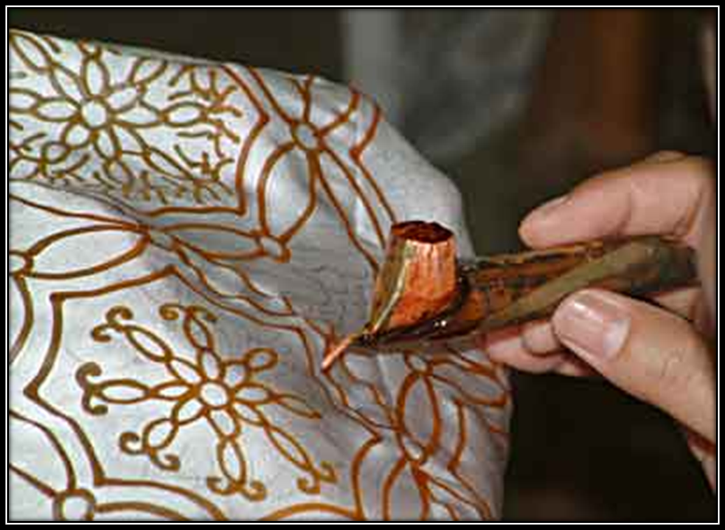
To make a batik, selected areas of the cloth are blocked out by brushing or drawing hot wax over them.

Slide 6
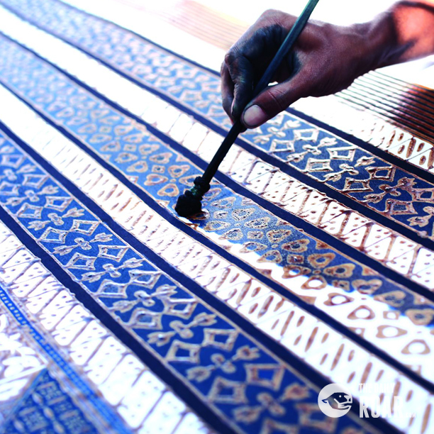
The cloth is then dyed. The parts covered in wax resist the dye and remain the original color.

Slide 7
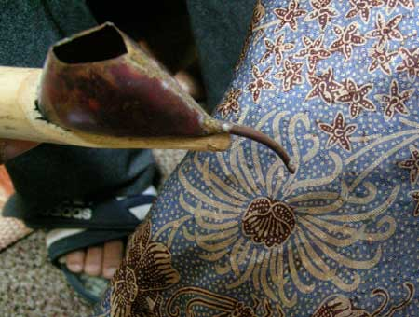
A Canting is the traditional Indonesian tool that is used to apply wax in fine dots and lines on a cloth.

Slide 8
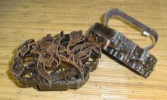
A cap (pronounced chop) is a copper stamp also used to make the designs

Slide 9
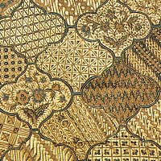
Although there are thousands of different batik designs, particular designs have usually been associated with traditional festivals and specific religious ceremonies.

Slide 10
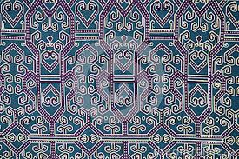
Previously, it was thought that certain cloth had mystical powers to ward off ill fortune, while other pieces could bring good luck.

Slide 11
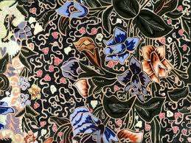
Certain batik designs are reserved for brides and grooms as well as their families.

Slide 12
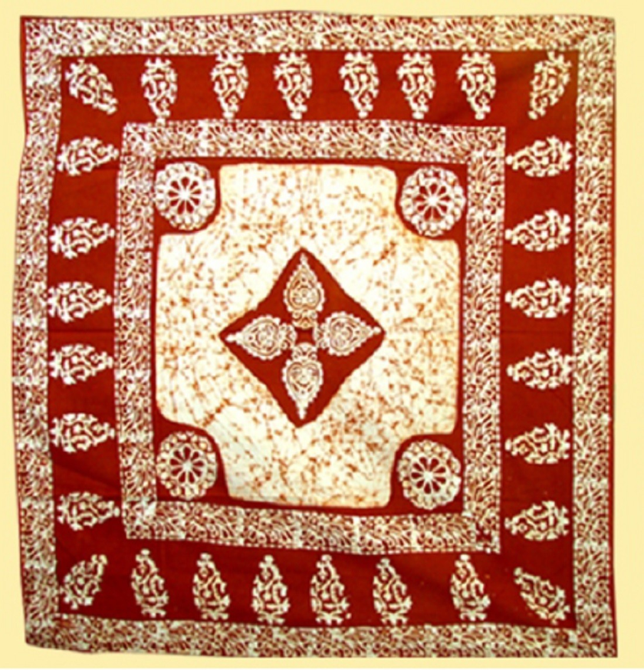
Other designs are reserved for the Sultan and his family or their attendants. A person's rank could be determined by the pattern of the batik he/she wore.

Slide 13
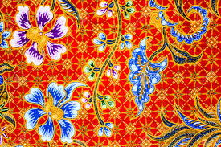
Certain batik designs are associated with the area that they are created.

Slide 14
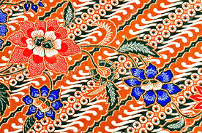
Batik cloth can be used for things like: shirts, dresses, scarves, pillows, purses, bags, curtains, etc.

Slide 15
https://www.youtube.com/watch?v=UDsD5sQOF_A

